Slide 1

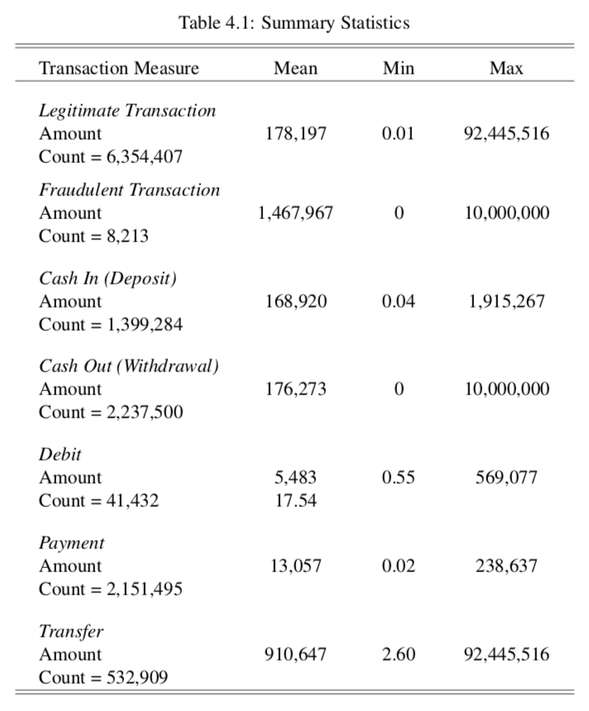
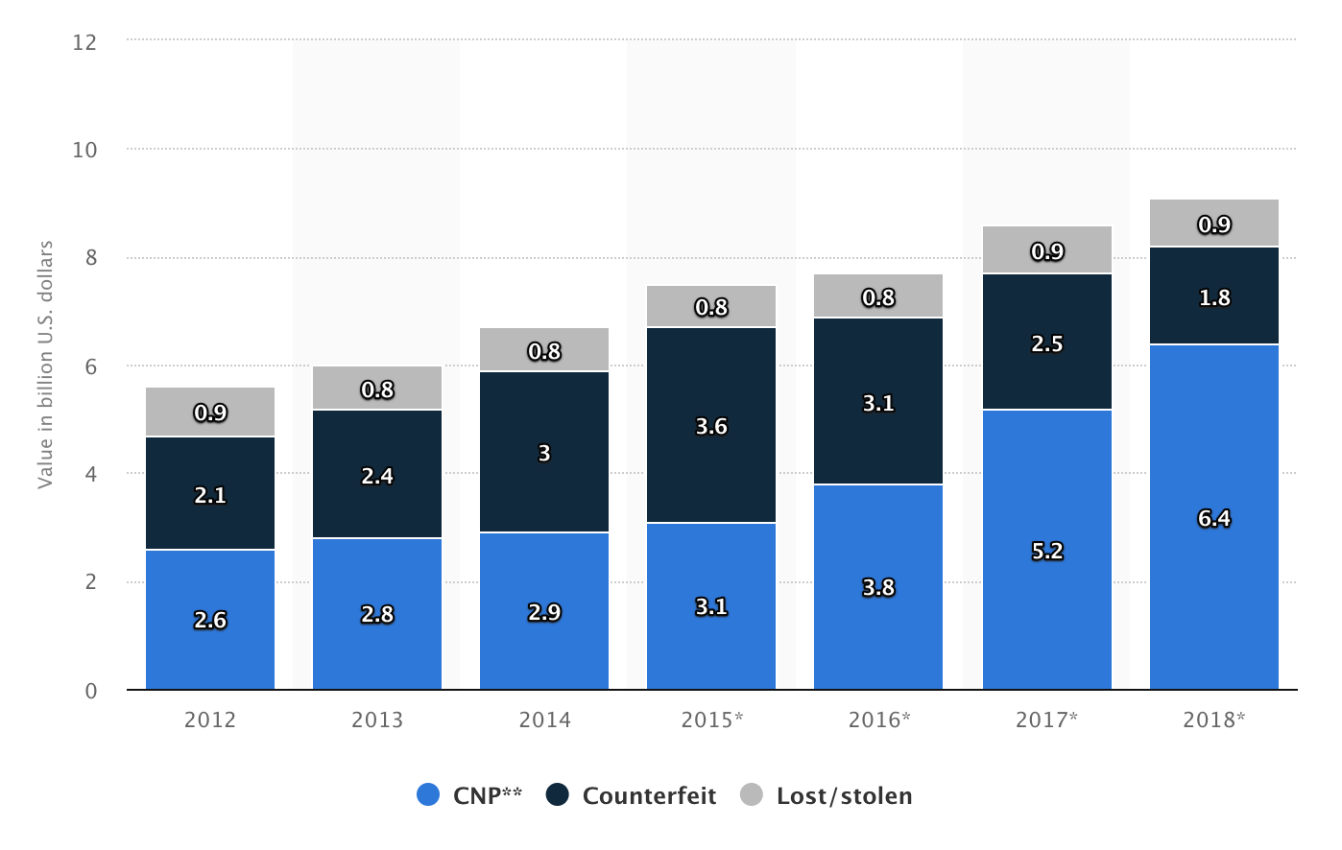
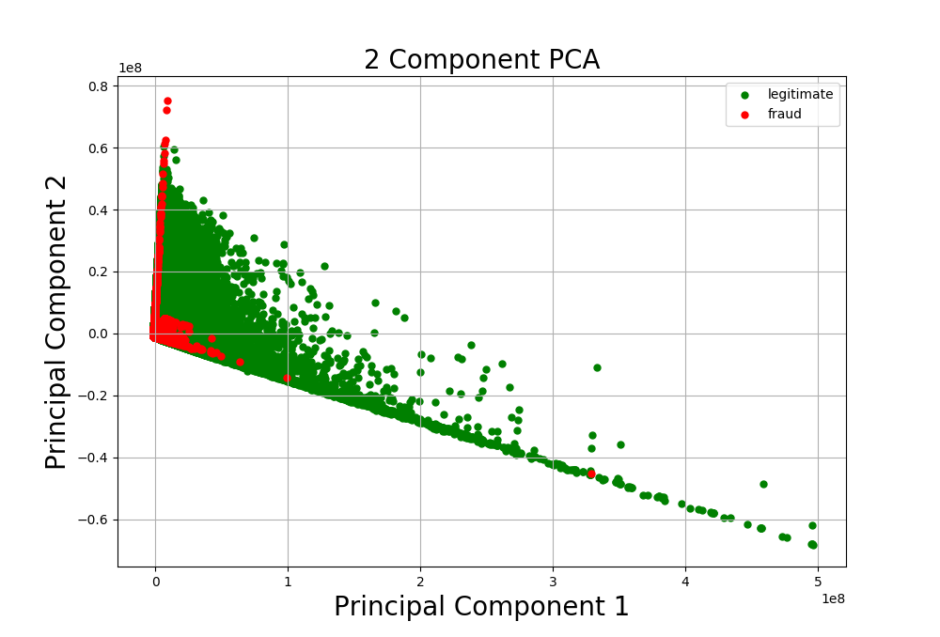
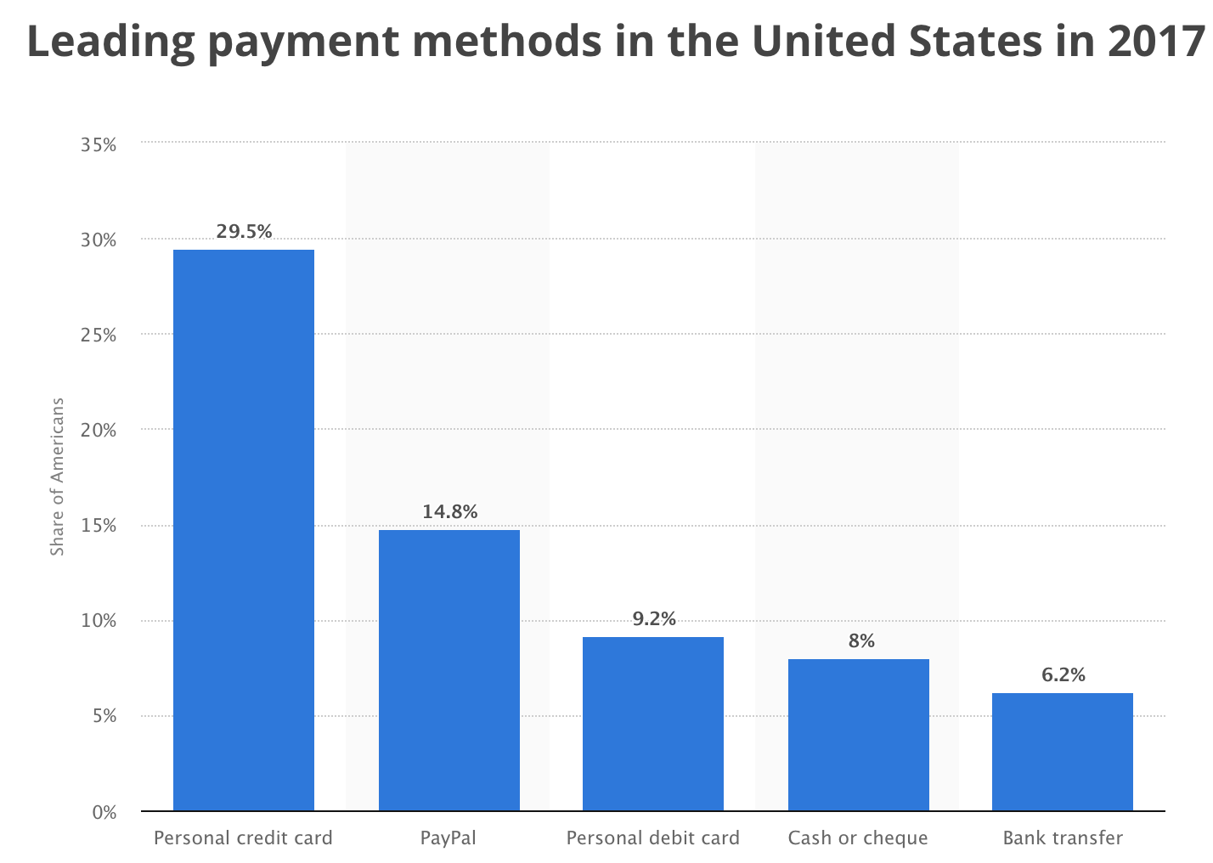
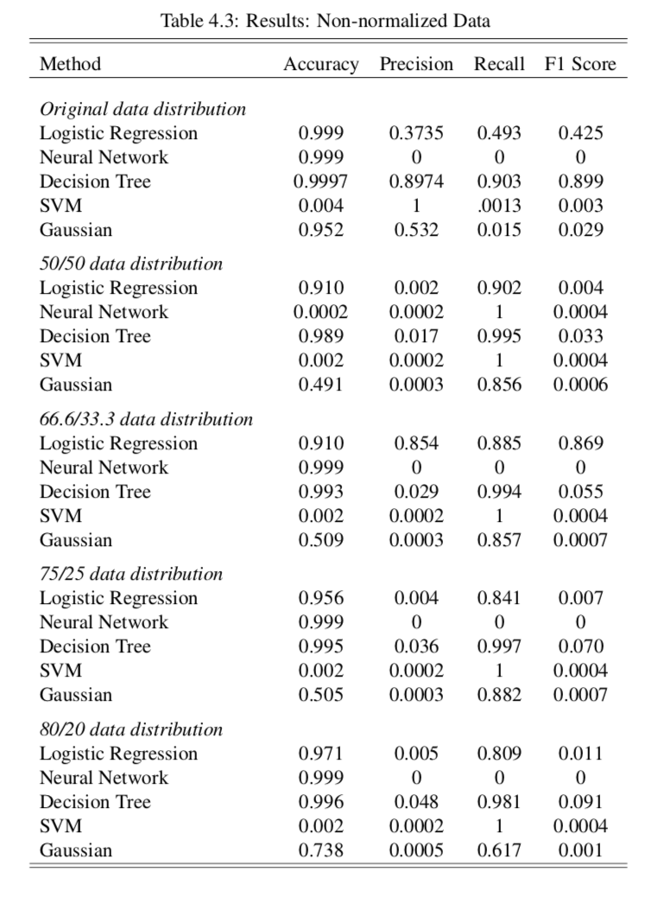
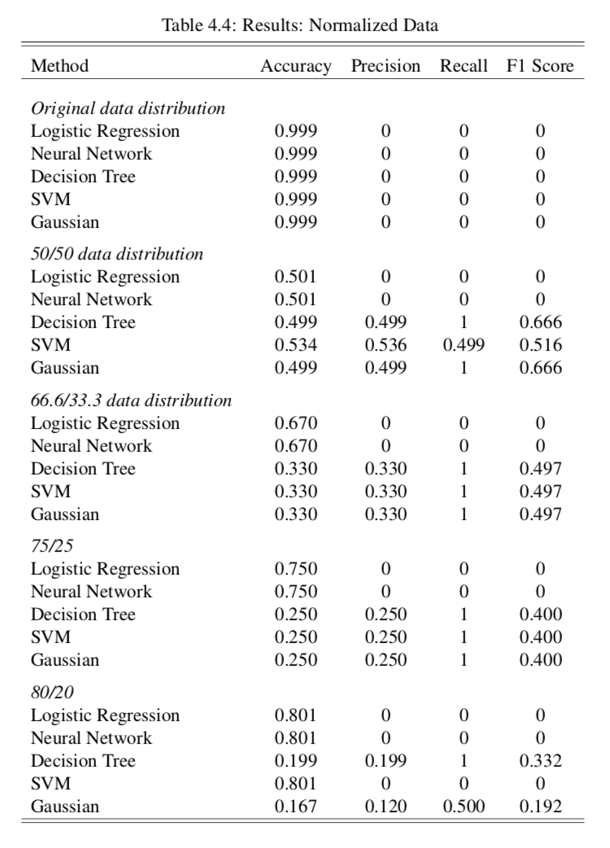
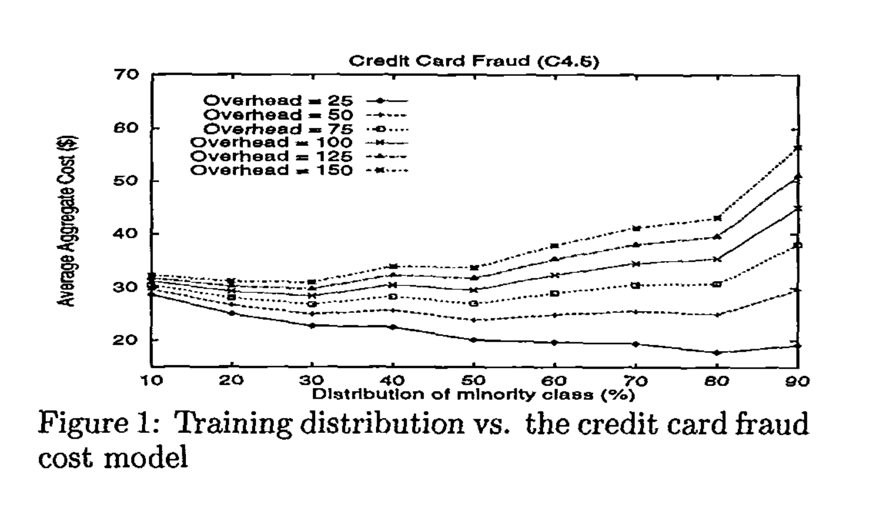
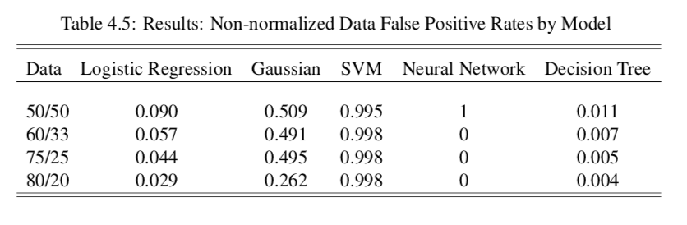
Combating Fraud By Leveraging Machine Learning
A CSCI Senior Thesis by Casey Astiz ‘19
Advised by Professor Michael Linderman
Fall 2018
Abstract
Methods
Interviews
Credit card fraud in the United States has been on the rise, reaching over $8 billion in 2018 [1]. The majority of these are card not present transactions, which have become more popular with the increasing options for online transactions. While fraud transactions are typically larger than the average transaction size, they are not frequent, as they only make up around 1-3% of transactions. Therefore, it is difficult to create unbiased classifiers for fraud detection systems because there are few examples to train on. In this thesis, I summarize related works on the topic of anomaly detection, feature engineering for fraud, and game theory. I interview practitioners in the fraud detection space to compare their knowledge and day-to-day methods with current research methods. I implement my own fraud detection system using a synthetic mobile payment transaction dataset. From this dataset, I find decision trees to be the most effective classifier, which is consistent to the practitioners' use of rule based systems.
Data Paysim: synthetic mobile payments with 6 million non-fraud, 8000 fraud [5]
Experiments
Interviewed 4 practitioners in fraud analytics. Example insights:
Training Data Distributions
Original Dataset
50/50
66/33
75/25
80/20
Models
SVM
Neural Network
Decision Tree
Logistic Regression
Gaussian
1) I hypothesized that fraud detection was more advanced in business than in research.
However, most businesses take simpler approaches than most recent research, and use manually created rule based systems or outsource their fraud detection.
2) Fraudsters use free trials, e.g. from Netflix or Spotify, to test out illicitly bought credit card information, then spending money on those cards that pass.
Summary Statistics
Introduction
Data Process
Example for a 50/50 data distribution. All data combined with random sampling.
6 M Non-Fraud
1/7 unskewed data + rest of Non-Fraud:
Testing Data
Discussion
Fraud rates in United States are rising as new payment methods are introduced [1, 2].
Instances of fraud are relatively rare, making up only 1-3% of transactions. Therefore, fraud is an anomaly.
Difficult to build unbiased classifiers when there is a large class imbalance.
50% Non-Fraud
50% Fraud
6/7 unskewed data: Training Data
8 K Fraud
Available Data Was Very Limited
Few repeated users
No location information
No address information
Very small proportion of fraud
Results
Non-normalized Data Results
Normalized Data Results
Results
Overlap between fraud and non-fraud data points.
Larger fraud training proportions increases sensitivity, leading to higher false positive rates (FPR). Tradeoffs depend on cost of fraud versus cost of investigation and lost business costs.
Small FPR increase of 0.03 leads to 180,000 more false positives in 6M transactions
Related Work
Conclusions
Skewed Classes
Artificially “unskew” your training data so a classifier sees more fraudulent examples.
50/50 training data distribution is best [3]
Measure success of model based on
Precision, Recall, and F1
Features Engineering
Deep Feature Synthesis to automatically create based on historical behavior [6]
Parenclitic Networks to measure relationships between features [7]
Game Theory
Incorporate human intuition and experience with fraud into rules
Predict next move of fraudster based on known behavior [4]
Decision Tree Classifiers have the best performance on this dataset. This is consistent with interviews, as they are similar to rule based systems.
Training data distributions can alter the sensitivity of a classifier to detecting the minority class.
As future work, would like to try combining a rule based system with a classifier to filter out highly likely licit transactions in first phase.
Decision Trees had highest F1 score
SVMs had lowest F1 score
Normalizing the data led to worse performance than non-normalized data.
Unskewing the data increases Total Positive Rate at cost of False Positive Rate
References
[1] Most popular payment methods in the U.S. 2017 — Statistic.
[2] U.S. payment card fraud losses by type 2018 — Statistic.
[3] Philip K Chan and Salvatore J Stolfo. Toward Scalable Learning with Non-uniform Class and Cost Distributions: A Case Study in Credit Card Fraud Detection. Technical report.
[4] Suvasini Panigrahi, Amlan Kundu, Shamik Sural, and A.K. Majumdar. Credit card fraud detection: A fusion approach using Dempster Shafer theory and Bayesian learning. Information Fusion, 10(4):354–363, Oct 2009.
[5] Paysim. Synthetic Financial Datasets For Fraud Detection — Kaggle.
[6] Roy Wedge, James Max Kanter, Kalyan Veeramachaneni, Santiago Moral Rubio, Sergio Iglesias Perez, Banco Bilbao, Vizcaya Argentaria, and Spain Madrid. Solving the ”false positives” problem in fraud prediction Automated Data Science at an Industrial Scale. Technical report.
[7] Massimiliano Zanin, Miguel Romance, Santiago Moral, and Regino Criado. Credit Card Fraud Detection through Parenclitic Network Analysis. Complexity, 2018:1– 9, may 2018.

